Slide 1
Different Types of CNN Architectures

Slide 2
Table of Contents
CNN and Types of Layer?
LeNet

Slide 3
What is CNN?
CNNs are a type of deep learning algorithm that are used to process data with a grid-like topology.
CNNs are a type of deep learning algorithm that is used to process data that has a spatial or temporal relationship.
CNNs are similar to other neural networks, but they have an added layer of complexity due to the fact that they use a series of convolutional layers.
Convolutional layers are an essential component of Convolutional Neural Networks (CNNs).

Slide 4
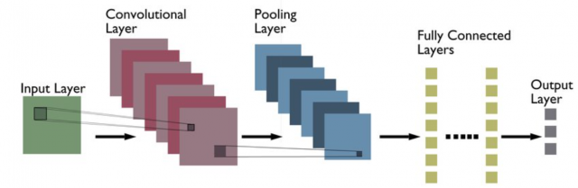

Slide 5
Layer Types
Convolutional (CONV)
Activation (ACT or RELU, where we use the same or the actual activation function)
Pooling (POOL)
Fully connected (FC)
Batch normalization (BN)
Dropout (DO)

Slide 6
Simple text diagrams to describe a CNN
INPUT => CONV => RELU => FC => SOFTMAX
.
Here, we define a simple CNN that accepts an input, applies a convolution layer, then an activation layer, then a fully connected layer, and, finally, a softmax classifier to obtain the output classification probabilities.
The SOFTMAX activation layer is often omitted from the network diagram as it is assumed it directly follows the final FC.

Slide 7
CNN Layers
CONV and FC (and to a lesser extent, BN) are the only layers that contain parameters that are learned during the training process.
Activation and dropout layers are not considered true “layers” themselves but are often included in network diagrams to make the architecture explicitly clear.
Pooling layers (POOL), of equal importance as CONV and FC, are also included in network diagrams as they have a substantial impact on the spatial dimensions of an image as it moves through a CNN.
CONV, POOL, RELU, and FC are the most important when defining your actual network architecture.

Slide 8
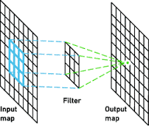
Convolutional layer
The CONV layer is the core building block of a Convolutional Neural Network.
The CONV layer parameters consist of a set of K learnable filters (i.e., “kernels”), where each filter has a width and a height, and are nearly always square.
These filters are small (in terms of their spatial dimensions) but extend throughout the full depth of the volume.
For inputs to the CNN, the depth is the number of channels in the image (i.e., a depth of three when working with RGB images, one for each channel). For volumes deeper in the network, the depth will be the number of filters applied in the previous layer.

Slide 9
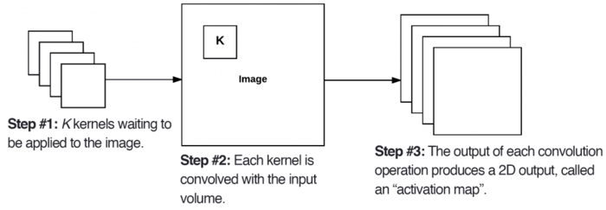
Let’s consider the forward-pass of a CNN, where we convolve each of the K filters across the width and height of the input volume. More simply, we can think of each of our K kernels sliding across the input region, computing an element-wise multiplication, summing, and then storing the output value in a 2-dimensional activation map

Slide 10
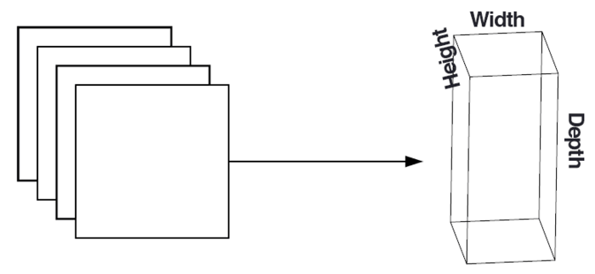
After applying all K filters to the input volume, we now have K, 2-dimensional activation maps. We then stack our K activation maps along the depth dimension of our array to form the final output volume

Slide 11
Covolution Layers
Every entry in the output volume is thus an output of a neuron that “looks” at only a small region of the input. In this manner, the network “learns” filters that activate when they see a specific type of feature at a given spatial location in the input volume. In lower layers of the network, filters may activate when they see edge-like or corner-like regions.
Then, in the deeper layers of the network, filters may activate in the presence of high-level features, such as parts of the face, the paw of a dog, the hood of a car, etc. This activation concept is as if these neurons are becoming “excited” and “activating” when they see a particular pattern in an input image.

Slide 12
Parameters
There are three parameters that control the size of an output volume: the depth, stride, and zero-padding size, each of which we’ll review below.

Slide 13
Depth
The depth of an output volume controls the number of neurons (i.e., filters) in the CONV
layer that connect to a local region of the input volume. Each filter produces an activation map that “activates” in the presence of oriented edges or blobs or color.
For a given CONV layer, the depth of the activation map will be K, or simply the number of filters we are learning in the current layer.
The set of filters that are “looking at” the same (x, y) location of the input is called the depth column.

Slide 14
Stride
Consider where we described a convolution operation as “sliding” a small matrix across a large matrix, stopping at each coordinate, computing an element-wise multiplication and sum, then storing the output.
This description is similar to a sliding window that slides from left-to-right and top-to-bottom across an image.

Slide 15

Using S = 1, our kernel slides from left-to-right and top-to-bottom, one pixel at a time, producing the following output (Table 2, left). However, if we were to apply the same operation, only this time with a stride of S = 2, we skip two pixels at a time (two pixels along the x-axis and two pixels along the y-axis), producing a smaller output volume (right).
Thus, we can see how convolution layers can be used to reduce the spatial dimensions of the input volumes simply by changing the stride of the kernel. Convolutional layers and pooling layers are the primary methods to reduce spatial input size.

Slide 16
Zero-padding
We need to “pad” the borders of an image to retain the original image size when applying a convolution — the same is true for filters inside of a CNN.
Using zero-padding, we can “pad” our input along the borders such that our output volume size matches our input volume size. The amount of padding we apply is controlled by the parameter P.

Slide 17
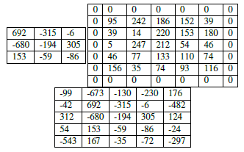
To visualize zero-padding, again refer to Table 1, where we applied a 3×3 Laplacian kernel to a 5×5 input image with a stride of S = 1.

Slide 18
Activation Layers
After each CONV layer in a CNN, we apply a nonlinear activation function, such as ReLU, ELU, or any of the other Leaky ReLU variants
Activation layers are not technically “layers” (due to the fact that no parameters/weights are learned inside an activation layer) and are sometimes omitted from network architecture diagrams as it’s assumed that an activation immediately follows a convolution.

Slide 19
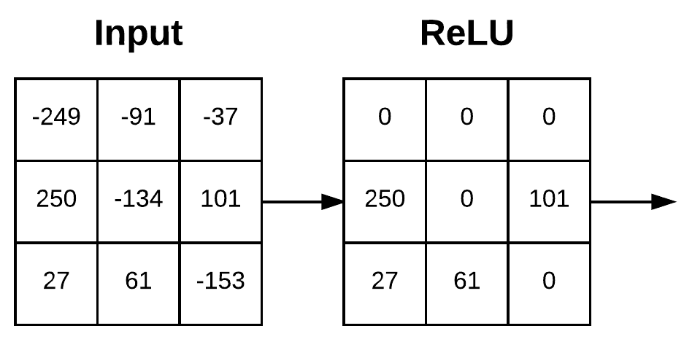
An activation layer accepts an input volume of size W_{input}×H_{input}×D_{input} and then applies the given activation function (Figure 4). Since the activation function is applied in an element-wise manner, the output of an activation layer is always the same as the input dimension, W_{input} = W_{output}, H_{input} = H_{output}, D_{input} = D_{output}.

Slide 20
Pooling layer
There are two methods to reduce the size of an input volume — CONV layers with a stride > 1 and POOL layers.
It is common to insert POOL layers in-between consecutive CONV layers in a CNN architectures:
The primary function of the POOL layer is to progressively reduce the spatial size (i.e., width and height) of the input volume. Doing this allows us to reduce the amount of parameters and computation in the network — pooling also helps us control overfitting.
INPUT => CONV => RELU => POOL => CONV => RELU => POOL => FC

Slide 21
Pooling layer
Pooling layers are a type of convolutional layer used in deep learning. Pooling layers reduce the spatial size of the input, making it easier to process and requiring less memory.
Pooling also helps to reduce the number of parameters and makes training faster.
There are two main types of pooling: max pooling and average pooling. Max pooling takes the maximum value from each feature map, while average pooling takes the average value.
Pooling layers are typically used after convolutional layers in order to reduce the size of the input before it is fed into a fully connected layer.

Slide 22
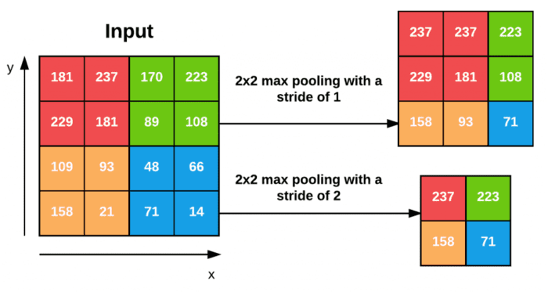

Slide 23
Fully connected layer
Fully-connected layers are one of the most basic types of layers in a convolutional neural network (CNN). As the name suggests, each neuron in a fully-connected layer is Fully connected- to every other neuron in the previous layer.
Fully connected layers are typically used towards the end of a CNN- when the goal is to take the features learned by the previous layers and use them to make predictions.
For example, if we were using a CNN to classify images of animals, the final Fully connected layer might take the features learned by the previous layers and use them to classify an image as containing a dog, cat, bird, etc.

Slide 24
CNN- Applications
CNNs are often used for image recognition and classification tasks. For example, CNNs can be used to identify objects in an image or to classify an image as being a cat or a dog.
CNNs can also be used for more complex tasks, such as generating descriptions of an image or 1 identifying the points of interest in an image.
CNNs can also be used for time-series data, such as audio data or text data.
CNNs are a powerful tool for deep learning, and they have been used to achieve state-of-the-art results in many different applications.

Slide 25
Different types of CNN Architectures

Slide 26
LeNet
LeNet was one of the first successful CNNs and is often considered the “Hello World” of deep learning. It is one of the earliest and most widely-used CNN architectures and has been successfully applied to tasks such as handwritten digit recognition.
The LeNet architecture consists of multiple convolutional and pooling layers, followed by a fully-connected layer. The model has five convolution layers followed by two fully connected layers.
LeNet was the beginning of CNNs in deep learning for computer vision problems. However, LeNet could not train well due to the vanishing gradients problem.
To solve this issue, a shortcut connection layer known as max-pooling is used between convolutional layers to reduce the spatial size of images which helps prevent overfitting and allows CNNs to train more effectively.

Slide 27
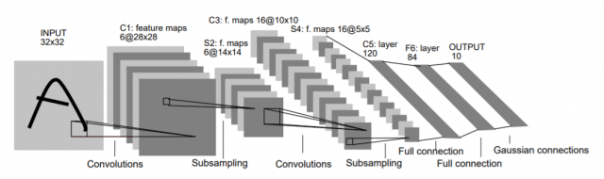

Slide 28
Applications of LeNet
The LeNet CNN is a simple yet powerful model that has been used for various tasks such as handwritten digit recognition, traffic sign recognition, and face detection. Although LeNet was developed more than 20 years ago, its architecture is still relevant today and continues to be used.

Slide 29
AlexNet
AlexNet is the deep learning architecture that popularized CNN. It was developed by Alex Krizhevsky, Ilya Sutskever, and Geoff Hinton.
AlexNet network had a very similar architecture to LeNet, but was deeper, bigger, and featured Convolutional Layers stacked on top of each other.
was the first large-scale CNN and was used to win the ImageNet Large Scale Visual Recognition Challenge (ILSVRC) in 2012. The AlexNet architecture was designed to be used with large-scale image datasets and it achieved state-of-the-art results at the time of its publication.
AlexNet is composed of 5 convolutional layers with a combination of max-pooling layers, 3 fully connected layers, and 2 dropout layers. The activation function used in all layers is Relu.
The activation function used in the output layer is Softmax. The total number of parameters in this architecture is around 60 million.

Slide 30
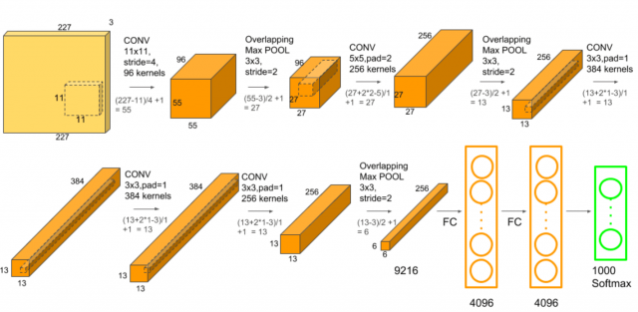

Slide 31
ZF Net
ZFnet is the CNN architecture that uses a combination of fully-connected layers and CNNs. ZF Net was developed by Matthew Zeiler and Rob Fergus.
It was the ILSVRC 2013 winner. The network has relatively fewer parameters than AlexNet, but still outperforms it on ILSVRC 2012 classification task by achieving top accuracy with only 1000 images per class.
It was an improvement on AlexNet by tweaking the architecture hyperparameters, in particular by expanding the size of the middle convolutional layers and making the stride and filter size on the first layer smaller.

Slide 32
ZF Net
It is based on the Zeiler and Fergus model, which was trained on the ImageNet dataset. ZF Net CNN architecture consists of a total of seven layers: Convolutional layer, max-pooling layer (downscaling), concatenation layer, convolutional layer with linear activation function, and stride one, dropout for regularization purposes applied before the fully connected output.
This CNN model is computationally more efficient than AlexNet by introducing an approximate inference stage through deconvolutional layers in the middle of CNNs

Slide 33
GoogLeNet
GoogLeNet is the CNN architecture used by Google to win ILSVRC 2014 classification task. It was developed by Jeff Dean, Christian Szegedy, Alexandro Szegedy et al..
It has been shown to have a notably reduced error rate in comparison with previous winners AlexNet (Ilsvrc 2012 winner) and ZF-Net (Ilsvrc 2013 winner).
In terms of error rate, the error is significantly lesser than VGG (2014 runner up). It achieves deeper architecture by employing a number of distinct techniques, including 1×1 convolution and global average pooling.

Slide 34
GoogLeNet
GoogleNet CNN architecture is computationally expensive. To reduce the parameters that must be learned, it uses heavy unpooling layers on top of CNNs to remove spatial redundancy during training and also features shortcut connections between the first two convolutional layers before adding new filters in later CNN layers.
Real-world applications/examples of GoogLeNet CNN architecture include Street View House Number (SVHN) digit recognition task, which is often used as a proxy for roadside object detection.

Slide 35
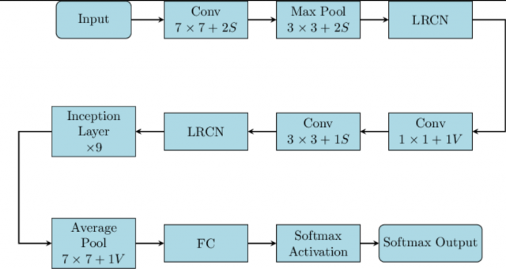

Slide 36
VGGNet
VGGNet is the CNN architecture that was developed by Karen Simonyan, Andrew Zisserman et al. at Oxford University. VGGNet is a 16-layer CNN with up to 95 million parameters and trained on over one billion images (1000 classes).
It can take large input images of 224 x 224-pixel size for which it has 4096 convolutional features. CNNs with such large filters are expensive to train and require a lot of data, which is the main reason why CNN architectures like GoogLeNet (AlexNet architecture) work better than VGGNet for most image classification tasks where input images have a size between 100 x 100-pixel and 350 x 350 pixels.

Slide 37
VGGNet- Applications
Real-world applications/examples of VGGNet CNN architecture include the ILSVRC 2014 classification task, which was also won by GoogleNet CNN architecture.
The VGG CNN model is computationally efficient and serves as a strong baseline for many applications in computer vision due to its applicability for numerous tasks including object detection.
Its deep feature representations are used across multiple neural network architectures like YOLO, SSD, etc.

Slide 38
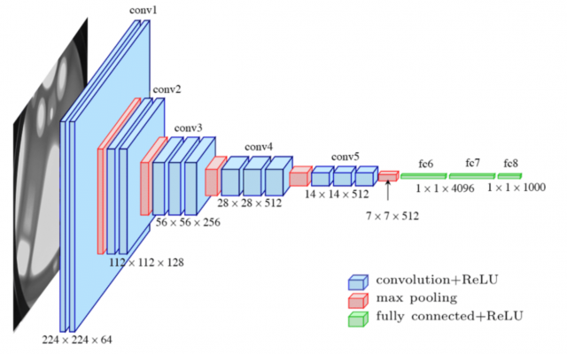

Slide 39
ResNet
ResNet is the CNN architecture that was developed by Kaiming He et al. to win the ILSVRC 2015 classification task with a top-five error of only 15.43%. The network has 152 layers and over one million parameters, which is considered deep even for CNNs because it would have taken more than 40 days on 32 GPUs to train the network on the ILSVRC 2015 dataset.
CNNs are mostly used for image classification tasks with 1000 classes, but ResNet proves that CNNs can also be used successfully to solve natural language processing problems like sentence completion or machine comprehension, where it was used by the Microsoft Research Asia team in 2016 and 2017 respectively.

Slide 40
ResNet
Real-life applications/examples of ResNet CNN architecture include Microsoft’s machine comprehension system, which has used CNNs to generate the answers for more than 100k questions in over 20 categories.
The CNN architecture ResNet is computationally efficient and can be scaled up or down to match the computational power of GPUs.

Slide 41
MobileNets
MobileNets are CNNs that can be fit on a mobile device to classify images or detect objects with low latency. MobileNets have been developed by Andrew G Trillion et al..
They are usually very small CNN architectures, which makes them easy to run in real-time using embedded devices like smartphones and drones.
The architecture is also flexible so it has been tested on CNNs with 100-300 layers and it still works better than other architectures like VGGNet.

Slide 42
MobileNets - Applications
Real-life examples of MobileNets CNN architecture include CNNs that is built into Android phones to run Google’s Mobile Vision API, which can automatically identify labels of popular objects in images.

Slide 43
GoogLeNet_DeepDream
GoogLeNet_DeepDream is a deep dream CNN architecture that was developed by Alexander Mordvintsev, Christopher Olah, et al..
It uses the Inception network to generate images based on CNN features.
The architecture is often used with the ImageNet dataset to generate psychedelic images or create abstract artworks using human imagination at the ICLR 2017 workshop by David Ha, et al.

Slide 44
https://pyimagesearch.com/2021/05/14/convolutional-neural-networks-cnns-and-layer-types/

